Slide 1
Wildlife Trade Prediction Using AI & Data Science
Pina Solanki

Slide 2
• Problem Statement:
Illegal wildlife trade is one of the biggest threats to biodiversity, leading to species endangerment and ecological imbalances. Traditional monitoring methods struggle to track and predict wildlife trade patterns due to the vast amount of unstructured data. This project leverages AI and Data Science techniques to analyze wildlife trade data, identify patterns, and predict potential illegal activities using structured datasets

Slide 3
• Brief Overview
This project aims to use machine learning and data analytics to study wildlife trade patterns from historical data. By analyzing the types of traded wildlife products, their taxonomic classification, and associated trade categories, the model can identify high-risk species and trade routes. The dataset, sourced from wildlife trade records, consists of categorized wildlife products, taxonomic details, and usage classifications. Using predictive modeling techniques, the project seeks to detect anomalies and forecast possible illegal trade activities.
Key technologies used include Python, PySpark, Machine Learning, and Data Visualization to process large datasets and generate actionable insights

Slide 4
• Key Objectives:
Data Analysis & Preprocessing: Clean and structure the dataset for meaningful insights.
Pattern Recognition: Identify trends in wildlife trade based on product categories and species data.
Predictive Modeling: Use AI/ML models to forecast potential illegal trade hotspots.
Risk Assessment: Highlight high-risk species and regions for conservation efforts.
Visualization & Reporting: Present findings through interactive dashboards and reports for stakeholders

Slide 5
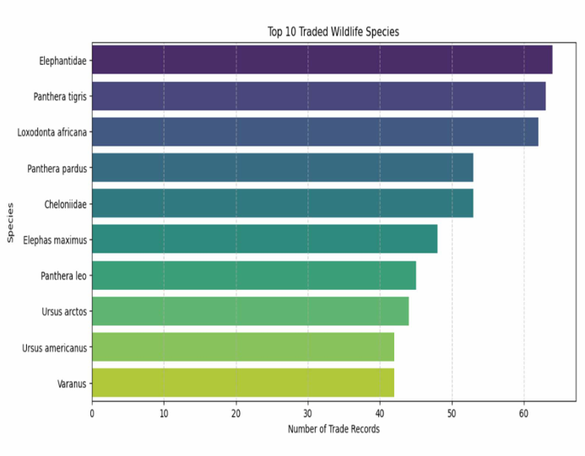
• Dataset Overview Dataset Description Source: The dataset contains wildlife trade records from various sources. Size: 15,492 records with 9 columns

Slide 6
Key Features:
Original_Use_Type: Type of traded wildlife product (e.g., Tusk, Ivory - worked).
Main_Category: Broad classification (e.g., Dead/Raw, Processed/Derived).
Clean_Taxa_Name: Scientific name of the species involved in trade.
Species_ID_(GBIF): Unique identifier for species classification.
This dataset helps analyze trade trends and develop predictive models to detect illegal wildlife trade activities

Slide 7
Data Preprocessing: Approach: Steps Taken to Solve the Problem
Data Collection & Preprocessing
• Loaded the dataset and cleaned missing or inconsistent data.
• Standardized species names and trade categories.
Exploratory Data Analysis (EDA)
• Visualized trade patterns across species and categories.
• Identified the most frequently traded species and items.
Feature Engineering
• Selected key variables affecting wildlife trade prediction.
• Created new features to improve model performance.
Model Selection & Training
• Applied classification models (Decision Tree, Random Forest).
• Used time-series forecasting for trade trend prediction

Slide 8
Visual Analysis:
Correlation Heatmap: Shows relationships between numeric features.
Scatter Plot: Visualizes how wildlife trade volume varies with species categories and risk factors.
Bar Plot: Compares the distribution of wildlife trade across different product categories (e.g., Tusk, Ivory, Skins).
Pie Chart: visualizing the proportion of different categories in wildlife trade.
Pair Plot: Visualizes pairwise relationships between variables like species, trade volume, geographic region, and trade category, helping identify clusters or correlations associated with illegal trade patterns

Slide 9
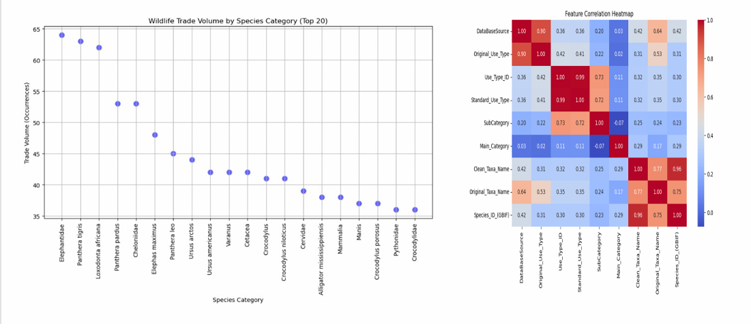
Data visualization:

Slide 10
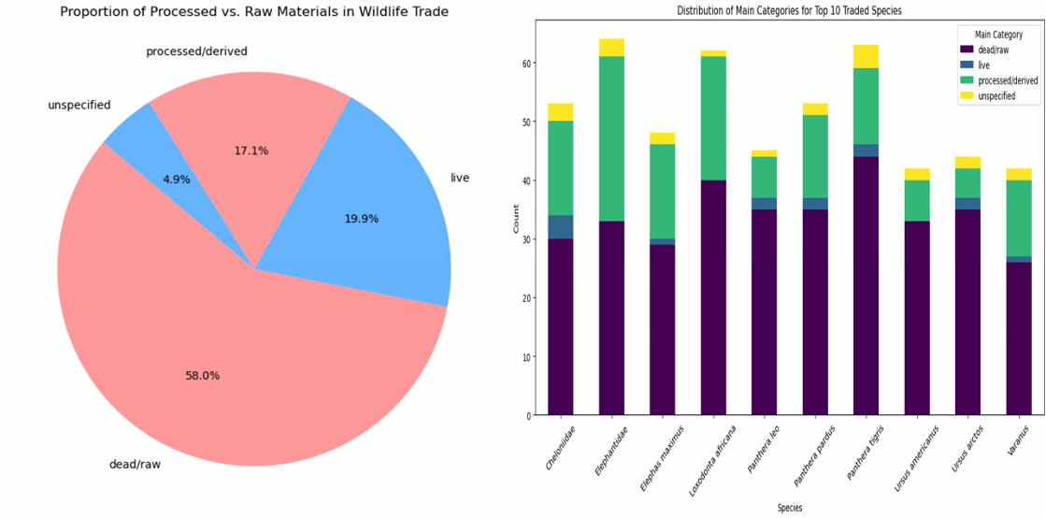

Slide 11
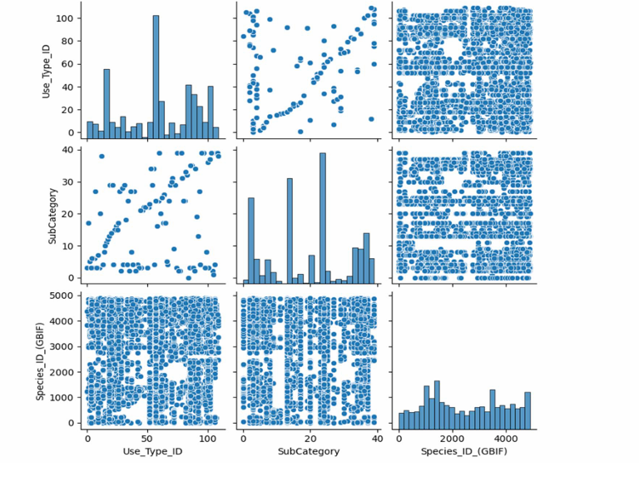

Slide 12
Methodology:
Approach:
Data Collection & Loading: Load the dataset using pandas and Inspect the data structure with df.head(), df.info(), and df.describe().
Data Preprocessing: Handle missing values and Check for duplicate records Convert categorical data to numerical if necessary. ➢
Exploratory Data Analysis (EDA): Visualize distributions of numerical features and Check correlations using a heatmap. ➢
Model Selection & Training: Split data into training and test sets (train_test_split() from sklearn) and Choose appropriate Regression or Classification models.
Model Evaluation & Optimization: Use cross-validation and Compare multiple models and select the best-performing one.
Prediction & Interpretation: Make predictions on new data and interpret results using SHAP or feature importance plots

Slide 13
Algorithms Used:
Random Forest Classifier: Used for classification tasks and Implemented using sklearn ensemble. Random Forest Classifier.
Logistic Regression: Used for its simplicity, interpretability, and efficiency in predicting the probability of a binary outcome.
Reason for Selecting Logistic Regression:
Binary or Multi-Class Classification: Logistic Regression is well-suited for classification tasks where the target variable has discrete categories (e.g., different trade categories).
Interpretability: Logistic Regression provides straightforward interpretation of results through odds ratios and feature coefficients ➢ Baseline Model for Comparison: Logistic Regression serves as a simple and effective baseline model before testing more complex models like Random Forest or XGBoost

Slide 14
Conclusion:
This study leveraged AI and data science to analyze and predict illegal wildlife trade patterns. By using machine learning models on structured datasets, the project identified high-risk species, trade hotspots, and anomalies in trading activities. Exploratory data analysis highlighted key trends in wildlife trade, while predictive models such as decision trees and random forests provided insights into potential future illegal trade activities. The results help conservationists and authorities take proactive measures against illegal wildlife trafficking.

Slide 15
Future Work:
Enhanced Data Collection: Incorporate real-time trade data from multiple sources (e.g., social media, trade databases).
Deep Learning Models: Implement advanced neural networks for better pattern recognition.
Geospatial Analysis: Use GIS and satellite imagery to detect illegal trade routes.
Policy Integration: Collaborate with regulatory bodies to implement AI-driven monitoring systems .
Interactive Dashboards: Develop real-time visual analytics tools for stakeholders to track trade trends

Slide 16
References:
https://www.wildlifetradeportal.org/incidents
https://figshare.com/articles/dataset/Dataset_of _seized_wildlife_and_their_intended_uses/149 14773?file=28717758
https://chat.openai.com
www.deepseek.com

Slide 17
Thank You

